Slide 1
0510-7255 – Deep Learning Final Project
NAS-Based Image denoising
Barak mamistvalov, roy hachnochi

Slide 2
Table of Contents
Background
Chosen paper
Method
Results
Conclusion

Slide 3
Background
NAS (Neural Architecture Search) – Automate the process of designing models’ architectures.
A subtask is finding efficiency-aware architectures which may be used on compact devices.
MobilNetV3 – Manually designed for mobile devices.
Widely used as a building block for NAS methods.
Our aim is to perform efficient image denoising.

Slide 4
Chosen Paper – HardCoRe-NAS
“HardCoRe-NAS: Hard Constrained diffeRentiable Neural Architecture Search” [Nayman, Aflalo et. al.]
Searched for architectures validation accuracy under predefined latency constraints.
Used a differentiable NAS approach by applying the stochastic Frank-Wolfe algorithm.
Originally designed for the image classification task.
Achieved excellent results for the latency-accuracy tradeoff.

Slide 5
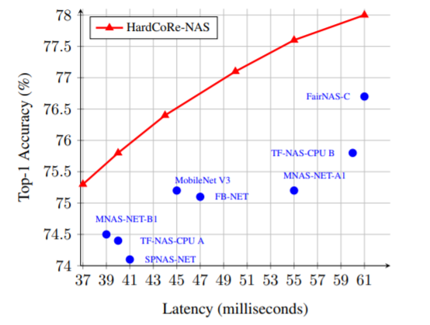
Chosen Paper – HardCoRe-NAS

Slide 6
Method
Weighted Nuclear Norm Minimization for Video Denoising (WNNVD).
The naive solution: Apply WWNID separately per frame.
Main Challenges:
Utilize temporal data (which is not used by the WNNID).
Integrate ideas and solutions from different papers.
Out of Scope:
Processing RGB images.
Non-Causal algorithm.

Slide 7
Literature Review – key papers
“A singular value thresholding algorithm for matrix completion” - Presented the NNM as a convex relaxation for the low-rank minimization problem.
“Image Denoising by Sparse 3-D Transform-Domain” (BM3D) - Was SOTA algorithm and used as comparison. Also, this paper uses the same grouping method as WNNID – block matching (BM).
“Video Denoising by Sparse 3D Transform-Domain Collaborative Filtering” – Proposed a grouping method which creates blocks from videos, utilizing temporal data. Our Block Matching is based on this method.
"Video Denoising, Deblocking, and Enhancement Through Separable 4-D Nonlocal Spatiotemporal Transforms“ (VBM4D) – Proposed a different grouping method. First creating temporal trajectories of patches and then search for similar trajectories. This is an addition to our project that we implemented.

Slide 8
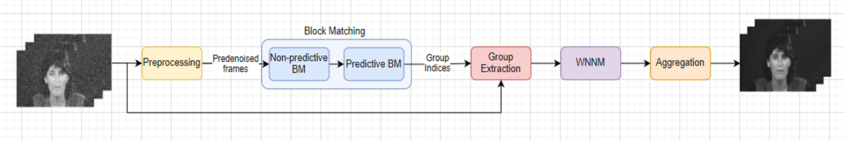
WNNVD – General Description
Algorithm block diagram:
The grouping step (“Block Matching”) has the most complicated, and most important logic.

Slide 9
WNNVD – Preprocessing
A simple and naïve video denoising, e.g Gaussian filter and Median filter.
The purpose of this step is to enhance the performance of the following block matching.

Slide 10
WNNVD – Block Matching
The grouping step. Each group will consist of similar patches both spatially and temporally.
Grouping from different frames is done sequentially.
A list of reference patches is chosen from a single frame
In our case we choose them by grid
“Past” and “Future” frames handled separately.
Done in 2 steps:
Non-Predictive Search –
Executed only in the current reference frame.
Predictive Search –
Executed on the “past” and “future” frames.
Around each similar patch from the previous frame, we open a search window to find a defined number of similar patches.

Slide 11
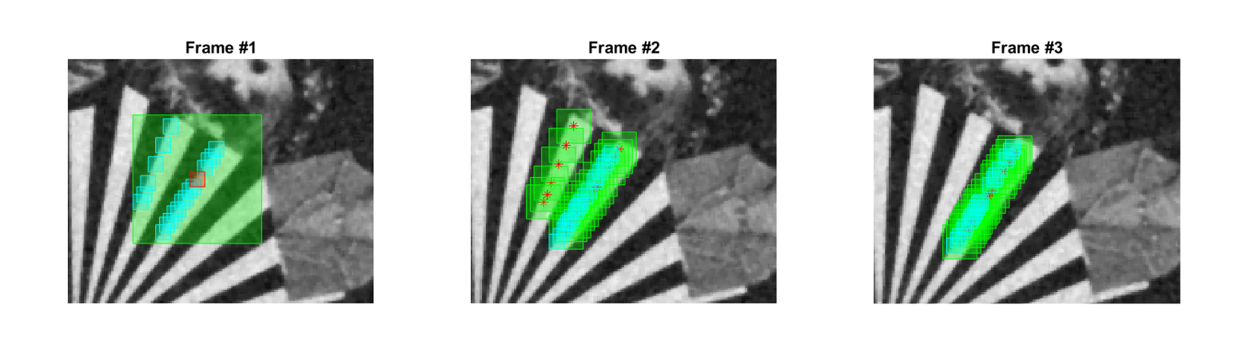
WNNVD – Block Matching (Example)
Red – Reference patch.
Green – Search windows.
Cyan – Matched patches.

Slide 12
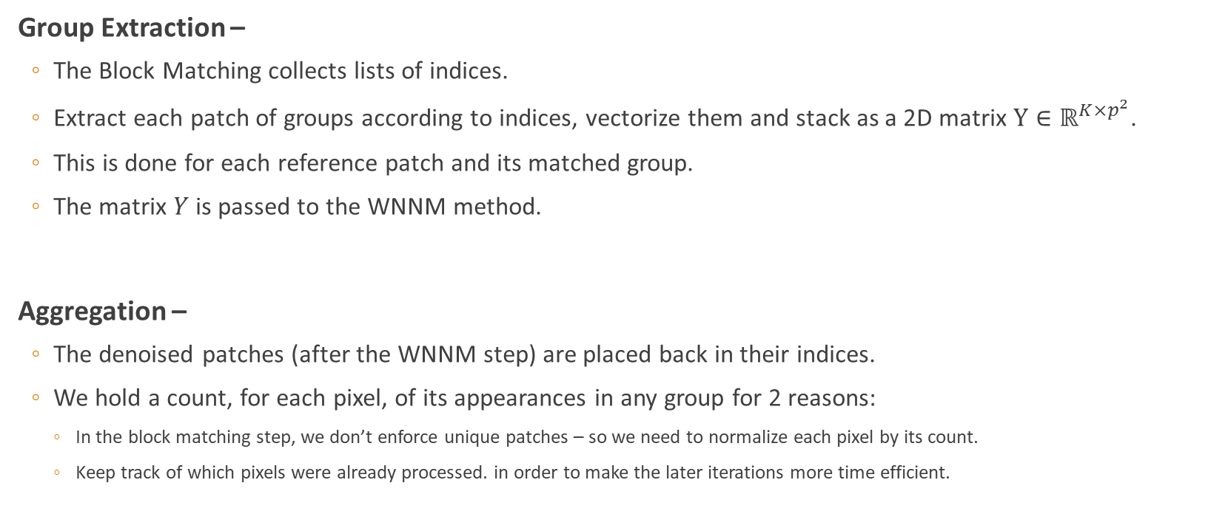
WNNVD – Group Extraction, Aggregation
Group Extraction –
The Block Matching collects lists of indices.
Extract each patch of groups according to indices, vectorize them and stack as a 2D matrix $Y∈ℝ^{K×p^{2}}$.
This is done for each reference patch and its matched group.
The matrix $Y$ is passed to the WNNM method.
Aggregation –
The denoised patches (after the WNNM step) are placed back in their indices.
We hold a count, for each pixel, of its appearances in any group for 2 reasons:
In the block matching step, we don’t enforce unique patches – so we need to normalize each pixel by its count.
Keep track of which pixels were already processed. in order to make the later iterations more time efficient.

Slide 13
WNNVD –WNNM
The denoising step. Based on the mathematical concepts that were presented.
Executed similarly to our reference paper - On 2D matrices.
Each matrix represents a matched group, where each column is a vectorized patch.

Slide 14

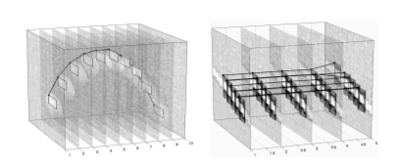
WNNVD – Extension
We attempted to emphasize the temporal data because of its importance.
As explained in VBM4D, SOTA paper for video denoising.
The main modification is the “Block Matching” block –
Instead of grouping patches, we group “trajectories”.
Trajectory consists of sequence of patches from sequential frames, one from each frame.
Each trajectory is created by harnessing the existing predictive and non-predictive search, more sophisticated ways were considered but would exceed the scope of the project.

Slide 15
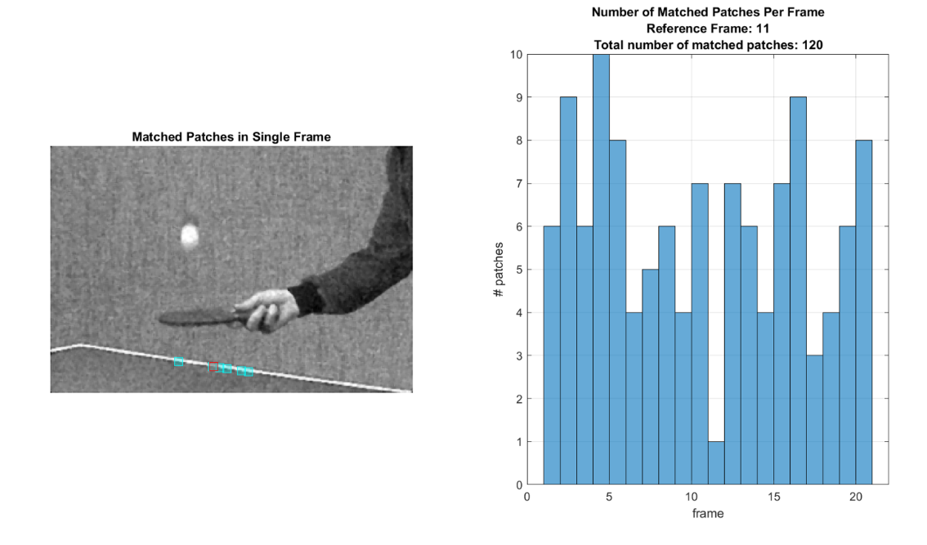
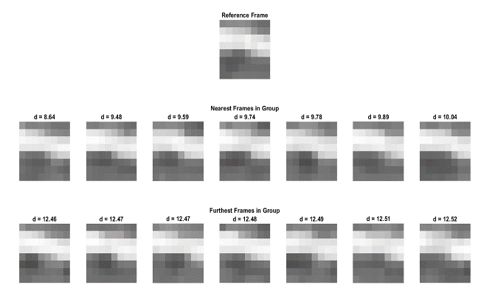
Results – Block Matching

Slide 16
Results – Parameter Analysis

Slide 17
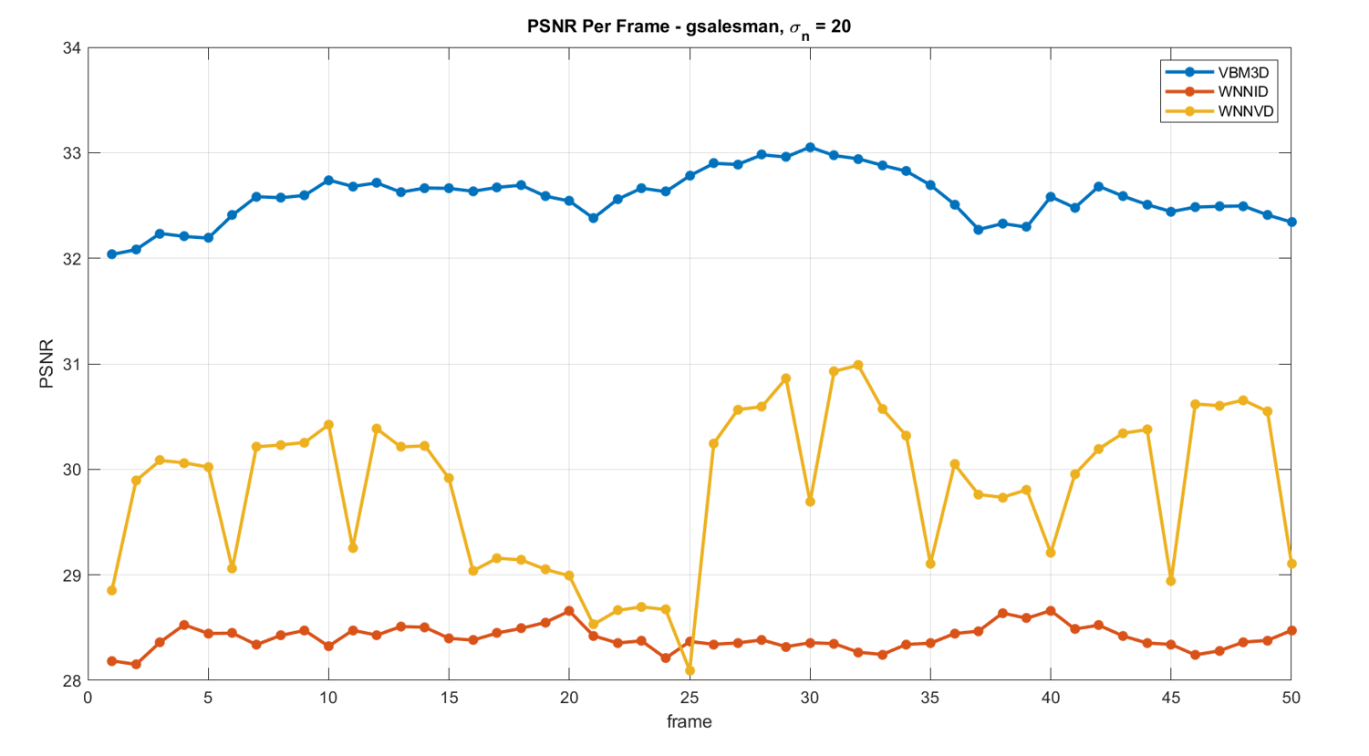
Results - Comparison

Slide 18
Results - Comparison
Noise STD | Video | Algorithm | PSNR | SSIM | Time per frame [sec]
10 | gbicycle | VBM3D | 36.5 | 0.97 | 1.12
 |  | WNNID | 34.2 | 0.97 | 73.35
 |  | WNNVD | 36.1 | 0.97 | 62.92
 | gflower | VBM3D | 29.8 | 0.95 | 0.19
 |  | WNNID | 27.7 | 0.93 | 11.23
 |  | WNNVD | 28.8 | 0.94 | 12.03
 | gmissa | VBM3D | 39.3 | 0.93 | 0.26
 |  | WNNID | 37.8 | 0.92 | 21.12
 |  | WNNVD | 38.2 | 0.92 | 16.23
 | gsalesman | VBM3D | 36.4 | 0.95 | 0.24
 |  | WNNID | 32.9 | 0.91 | 19.24
 |  | WNNVD | 34.2 | 0.92 | 10.18
 | gstennis | VBM3D | 31.8 | 0.87 | 0.21
 |  | WNNID | 29.6 | 0.83 | 16.55
 |  | WNNVD | 29.2 | 0.77 | 12.92
 | lena | WNNVD | 35.8 | 0.92 | 110.4
Noise STD | Video | Algorithm | PSNR | SSIM | Time per frame [sec]
20 | gbicycle | VBM3D | 33.6 | 0.95 | 1.13
 |  | WNNID | 29 | 0.92 | 72.36
 |  | WNNVD | 32.6 | 0.95 | 63.79
 | gflower | VBM3D | 27.5 | 0.91 | 0.19
 |  | WNNID | 23.7 | 0.85 | 11.01
 |  | WNNVD | 26 | 0.85 | 14.79
 | gmissa | VBM3D | 37.5 | 0.91 | 0.26
 |  | WNNID | 34.1 | 0.88 | 20.52
 |  | WNNVD | 35.5 | 0.9 | 17.37
 | gsalesman | VBM3D | 33.6 | 0.91 | 0.25
 |  | WNNID | 28.8 | 0.81 | 19.12
 |  | WNNVD | 30.1 | 0.82 | 11.78
 | gstennis | VBM3D | 29.6 | 0.77 | 0.21
 |  | WNNID | 26.8 | 0.67 | 16.39
 |  | WNNVD | 26.3 | 0.53 | 15.27
 | lena | WNNVD | 33.1 | 0.88 | 114
Noise STD | Video | Algorithm | PSNR | SSIM | Time per frame [sec]
30 | gbicycle | VBM3D | 31.1 | 0.93 | 1.13
 |  | WNNID | 26.5 | 0.9 | 71.66
 |  | WNNVD | 29.4 | 0.9 | 65.86
 | gflower | VBM3D | 25.4 | 0.86 | 0.19
 |  | WNNID | 21.2 | 0.78 | 11.07
 |  | WNNVD | 22.6 | 0.74 | 15.64
 | gmissa | VBM3D | 35.6 | 0.91 | 0.26
 |  | WNNID | 32.6 | 0.88 | 20.47
 |  | WNNVD | 33.3 | 0.88 | 18.24
 | gsalesman | VBM3D | 30.9 | 0.85 | 0.25
 |  | WNNID | 26.7 | 0.73 | 19.03
 |  | WNNVD | 27.3 | 0.72 | 13.27
 | gstennis | VBM3D | 27.7 | 0.66 | 0.21
 |  | WNNID | 25.3 | 0.57 | 16.22
 |  | WNNVD | 25.6 | 0.5 | 17.47
 | lena | WNNVD | 31.3 | 0.85 | 108.6

Slide 19
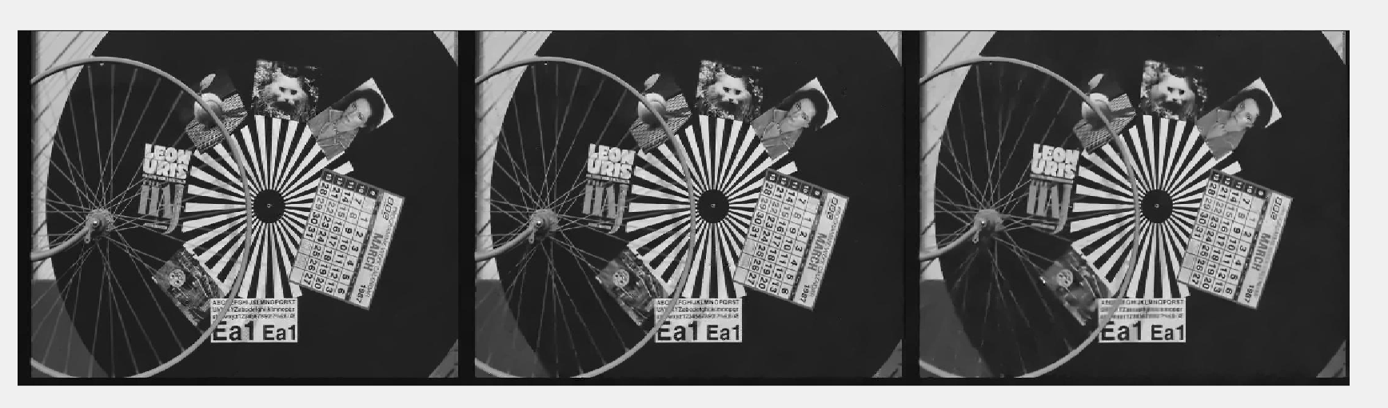
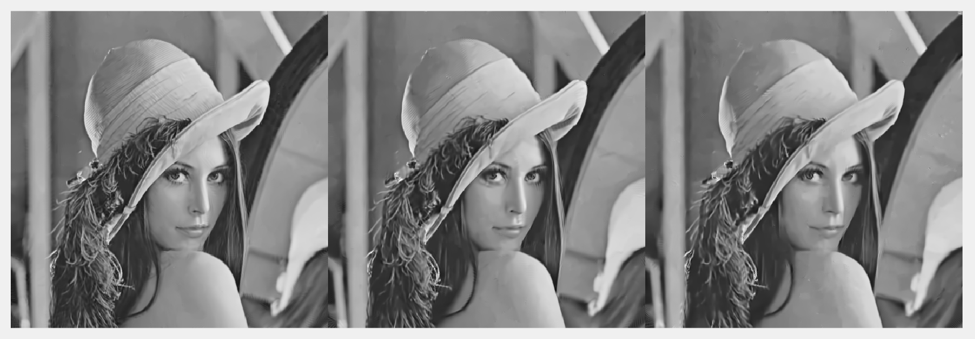
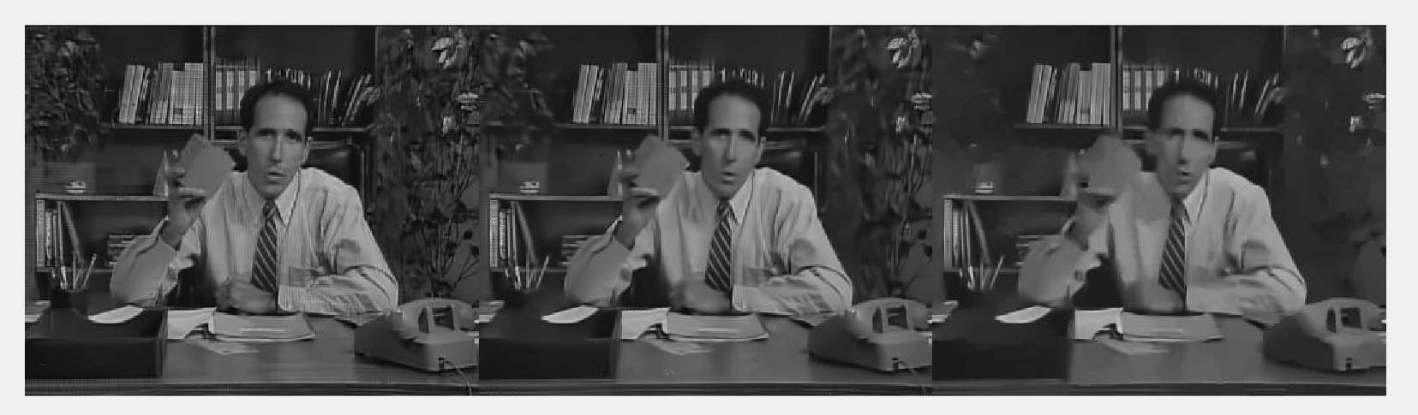
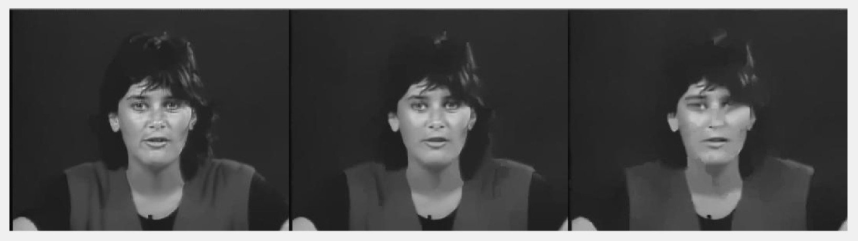
Results - Examples

Slide 20
Suggested Future Work
Parameter optimization.
Instead of vectorizing blocks, work with 3-D/4-D blocks and implement High-Order SVD.
Modify the algorithm for online video denoising (causal denoising).
Expand the algorithm to support RGB images/videos.
Optimize run-time.

Slide 21
Summary
The core signal-processing concept we studied is LRMA utilization for image and video denoising.
Specifically, NNM/WNNM relaxation methods.
We explored different ways of grouping methods (BM, TM).
We conducted analysis and research of our proposed algorithm.
We compared our results to SOTA papers in the classical regime of video and image denoising.

